Slide 1
The Compute Shader
DirectX Day 8

Slide 2

Outside the Pipeline: CS Stage
COMPUTE SHADER
Group Shared Memory
VRAM: Buffers, Structured Buffers, Raw Buffers, Append and Consume Buffers. Read & Write.

Slide 3
Compute Shader Stage
Exists apart from the rendering pipeline.
Designed for general purpose mass parallel algorithms. (GP GPU)
Only stage besides the Pixel Shader that can use Unordered Access Views.
Each execution is made up of a 3D array of Thread Groups which each contain a 3D array of threads.
This stage is completely optional.

Slide 4
Structured Buffers
Buffers that contain data not pre-defined by a DXGI format.
Provides a convenient way to work with custom data rather than adapting existing formats.
During creation of the buffer use D3D11_RESOURCE_MISC_BUFFER_STRUCTURED to identify the buffer along with the “StructuredByteStride” setting.
Also use DXGI_FORMAT_UNKNOWN when creating a resource view for a structured buffer.

Slide 5
Unordered Access Views
A special kind of view that enables read AND write access to a buffer from a pixel or compute shader.
When creating a Buffer Resource you must specify if it can be accessed with a UAV.
Behaviors that used to require two separate buffers (one for reading one for writing) can now be done in a single buffer.
We are also granted random access when writing data to a resource. This means we have a variety of ways to implement algorithms.

Slide 6
Byte Address Buffers
A.K.A Raw Buffers.
Designed to simply hold a block of bytes.
Create Buffer: D3D11_RESOURCE_MISC_BUFFER_ALLOW_RAW_VIEWS
View: D3D11_BUFFER_UAV_FLAG_RAW or D3D11_BUFFER_SRV_FLAG_RAW
Accessed with a byte offset similar to how you would access an unsigned char array in C++.
NOTE!: This offset must be a multiple of 4. The smallest retrievable value is 1 element of 1 GPU register. (4bytes)
Sometimes data you need to retrieve or manipulate may need to be stored in a non-linear fashion. The Raw buffer was designed to allow more generic access to data.
Other buffer types can optionally be accessed through a Raw Buffer view if required.

Slide 7
Append and Consume Buffers
An additional feature that only works on Structured Buffers.
Create a UAV with the flag: D3D11_BUFFER_UAV_FLAG_APPEND.
Allows you to synchronously remove and add items to the end of a structured buffer. (works like a stack)
Can be used to potentially optimize access to data that can be operated on in isolation. (EX: a particle)

Slide 8
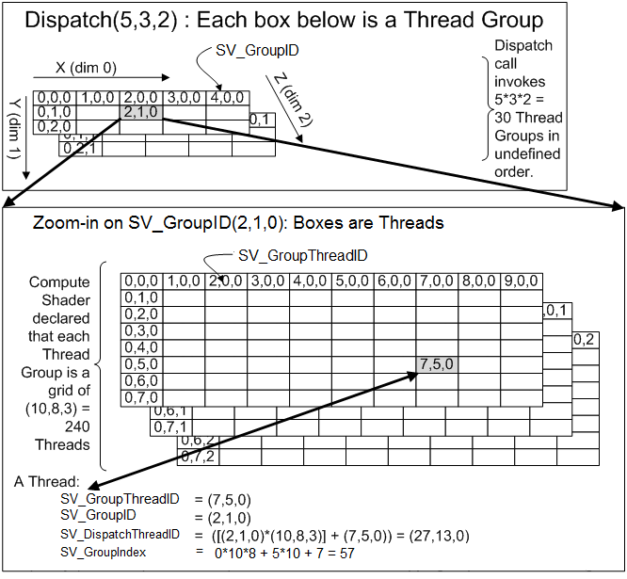
Thread Groups
A thread group is an array of individual threads.
A thread group can have up to three dimensions.
The size of a thread group is defined in the compute shader itself.
By having three dimensions we can tailor the layout of our GPU threads to match a specific problem type.

Slide 9
Compute Shader: Dispatch
Compute Shaders are not drawn, they are Dispatched.
To execute a Compute Shader you must bind all the relevant resources as usual and then decide how many Thread Groups you want to launch.
Just like thread groups, the Dispatch itself is capable of 3 dimensions. This enables matching your threads to almost whatever kind of data layout you are using.
Total Threads = (Dx*Dy*Dz) * (TGx*TGy*TGz)
Properly determining the breakdown of thread groups dispatched can have a large impact on the performance of an algorithm.

Slide 10
Example Compute Shader
// input texture
texture2D height : register( t0 );
// output buffer
RWBuffer<float> results : register( u0 );
// type of shared data per thread
struct GSData
{
float3 xyz;
float scale;
};
// each thread shares this data with each other in the group
groupshared GSData data[5*5*1]; // does not have to match numthreads
// number of threads in one dispatched thread group
[numthreads(5,5,1)] // zero on any dimension would == no threads!
void main( uint index : SV_GroupIndex ) // many options here for thread ID
{
// grab some input data and perform computation
data[index].xyz = height[index, index >> 1].rgb;
data[index].scale = length(data[index].xyz); // magnitude = square root
// wait for other threads in group to reach this point
GroupMemoryBarrierWithGroupSync();
// use shared data pool to eliminate redundant calculations
results[index] = data[index].scale +
data[min( index+1, 24)].scale +
data[max( int(index)-1, 0)].scale;
// at this point two extra squareroot calculations per thread eliminated.
}

Slide 11
Group Shared Memory
You have three options when in comes to data access in a Compute Shader:
Buffer Resources:
This is the slowest data in and out of a Compute Shader but the only data that can actually be persisted. It also eclipses the other two options in storage capacity.
Thread Stack:
The fastest memory available to a thread. Used for local calculations it cannot be shared with other threads and has very limited size restrictions.
Group Shared Memory:
Slots in between the thread stack and buffer resources as far as speed and storage. This data is shared across a single thread group and enables threads to share data quickly without reading and writing to buffer resources.
Limited to 32Kb per group and not retained between Compute Shader dispatches. For this reason it is best used to store temporary calculations that need to be shared across threads.

Slide 12
Tips For Homework:
Before trying to get your particles moving, first just get them drawing.
Making a quad always face the camera is easy if you have the geometry shader build them directly in projection space.
When expanding a particle in projection space you may need to adjust for aspect ratio.
An easy performance optimization is to have the geometry shader determine if a particle is visible (hint: clip space) before it expands it to a quad.
Keep in mind UAVs allow for a great deal of flexibility. It is possible to use a single buffer for reading, writing, and even drawing your particles!

